Slide 1
Electric Grower Security Device Co. DATA Consulting
By Mike Wu

Slide 2
Top 3 Population Segmentation Common Profiles
Company should target 3 top segmentations :
Elite Household
Prosperous Achiever
Young Affluent Mobile
Marketing insights:
Targeted Groups with high income who are willing to afford high-end security product
Targeted Groups with higher value of house and real estate properties
Targeted Groups with higher tendencies to shop online and speclized store
Targted Groups with higher tendencies to trust internet, TV(2nd), Newspaper(3rd) Ads
Targted Groups diversed into 2 forms of age group 18-40, and 45-74

Slide 3
Propensity Score Calculation
Numerical Variable and Information Variable
Numerical Variable: Income, Purchase Attitude, House Value
Information Variables: Age, Purchase behaviors(Online or Physical store), Trusted Media Channel, Income, Purcahse Atitude, House Value,
Score the Degree and Calculate Total score
Degree: Low – Medium Low- Medium- Medium High-High
Score: More Weighted Variable 3-9
Less Weighted Variable: 2-6
Calculate Weighted score Sum(%*score)
Compare total score between Segements

Slide 4
Propensity Score Calculation

Slide 5
Customer Profiles: Elite Households
Demographic Profile
Age: 25-54 | Ethnicity: White/Hispanic/Asian/other
Income: 100K- 250K+ | Employments: Professional in Management/Social Elite
Residential Insurance : Preferred better policy feature than lower price | Average Household Size: 3-5
Psychologies and Behaviors | Elite Households
Buy Based on Quality- Not Price- Agree
Buying Electronics- Do As Much Research as Possible- Agree
Change Brands Often for Variety/Novelty- Agree
I am Willing to Pay More for Top Quality Electronics- Agree
Like to Shop Around Before Making a Purchase- Agree
Will Buy on Credit Rather than Wait- Agree
Will Switch Brands to Use a Cents-Off Coupon- Agree
Would like to buy Security Devices
Often Seek Advice of Others Before Buying- Agree
Wait for Others to Try Things Before I Buy- Agree
Media | Elite HH
Internet | 10
TV | 8
Newspaper | 6
Radio | 4
Magazines | 2

Slide 6
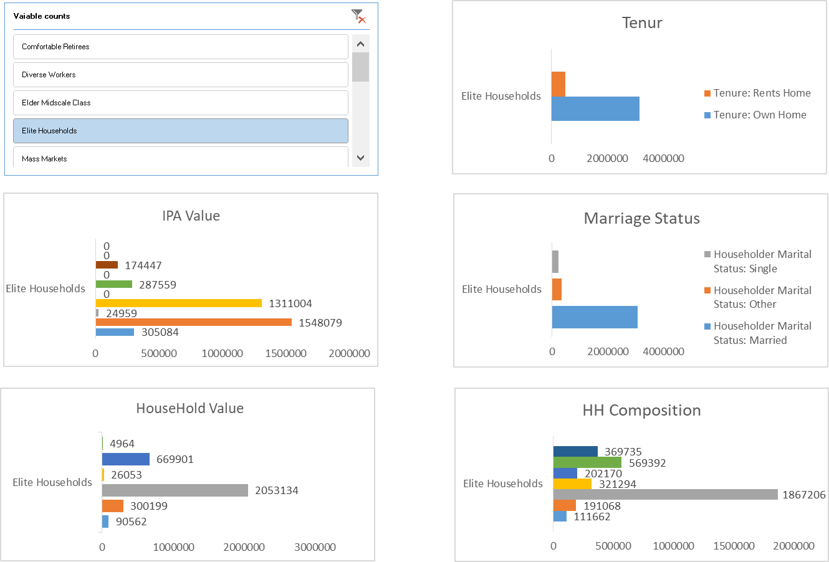
Demographics of Elite Households

Slide 7
Customer Profiles: Prosperous Achievers
Demographic Profile
Age: 45- 74 | Ethnicity: White/Hispanic/Other
Income: 100K-200K+ | Employments: Professional/Management
Residential Insurance: Preferred better policy feature than lower price | Average Household Size: 1-4
Psychologies and Behaviours | Prosperous Acheivers
Buy Based on Quality- Not Price- Agree
Buying Electronics- Do As Much Research as Possible- Agree
Change Brands Often for Variety/Novelty- Agree
I am Willing to Pay More for Top Quality Electronics- Agree
Like to Shop Around Before Making a Purchase- Agree
Will Buy on Credit Rather than Wait- Agree
Will Switch Brands to Use a Cents-Off Coupon- Agree
Would like to buy Security Devices
Often Seek Advice of Others Before Buying- Agree
Wait for Others to Try Things Before I Buy- Agree
Media | Prosperous Achiever
Internet | 10
TV | 8
Newspaper | 6
Radio | 4
Magazines | 2

Slide 8
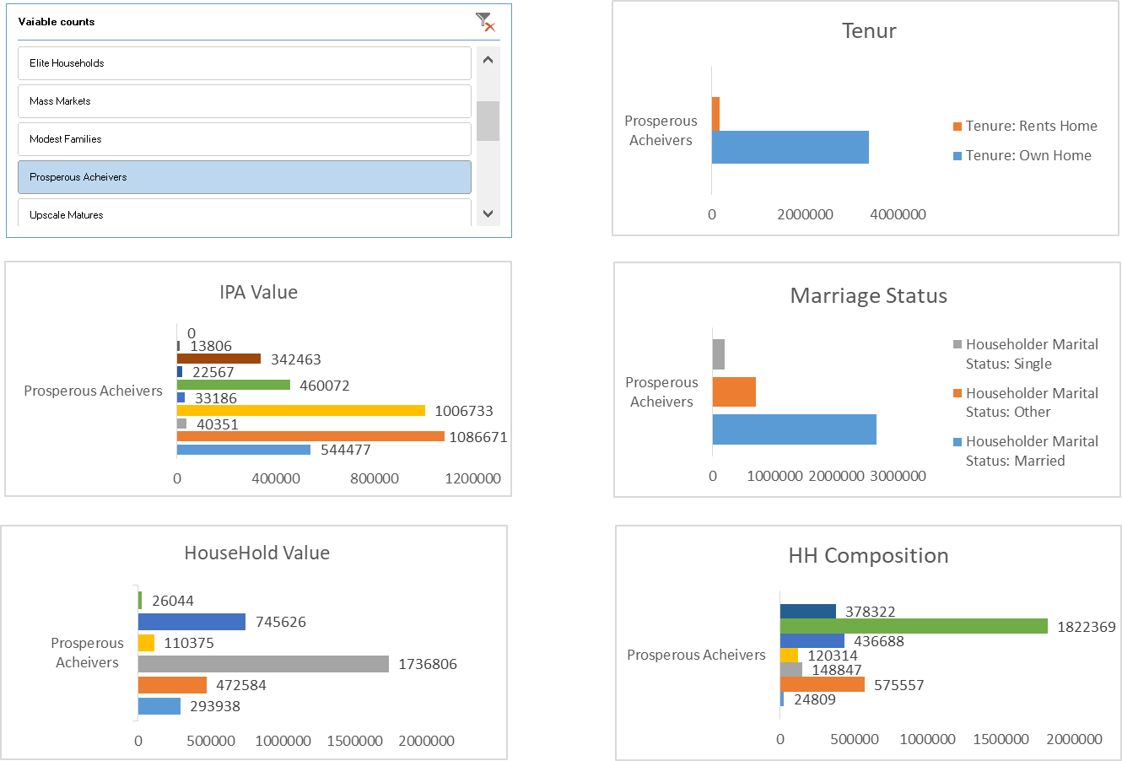
Demographics of Prosperous Achiever

Slide 9
Customer Profiles: Young Affluent Mobiles
Demographic Profile
Age:18-40+ | Ethnicity: White/Back/Hispanic
Income: 75K-150K+ | Employments: Professional/Management
Residential Insurance : Preferred better policy feature than lower price | Average Household Size: 1-3
Psychologies and Behaviors | Young Affluent Mobiles
Buy Based on Quality- Not Price- Agree
Buying Electronics- Do As Much Research as Possible- Agree
Change Brands Often for Variety/Novelty- Agree
I am Willing to Pay More for Top Quality Electronics- Agree
Like to Shop Around Before Making a Purchase- Agree
Will Buy on Credit Rather than Wait- Agree
Will Switch Brands to Use a Cents-Off Coupon- Agree
Would like to buy Security Devices
Often Seek Advice of Others Before Buying- Agree
Wait for Others to Try Things Before I Buy- Agree
Media | Young Affluent Mobile
Internet | 10
TV | 8
Newspaper | 6
Radio | 4
Magazines | 2

Slide 10
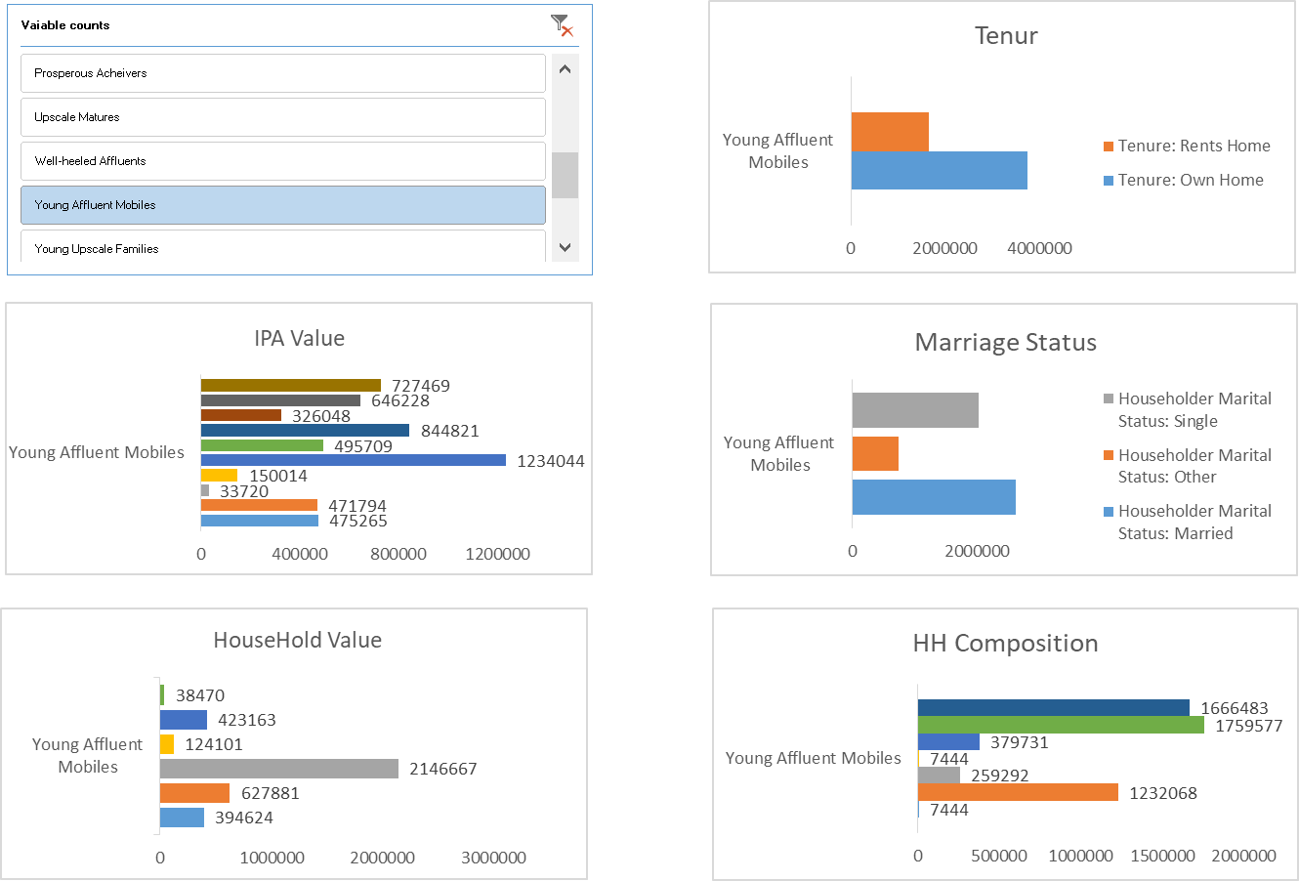
Demographic of Young Affluent Mobile

Slide 11
Key Location and Descriptions
Top 5 city | Score | Population Growth Rate | Crime Rate | Housing Construction | Top 3 Seg Population penetration %
Brooklyn | 16.3 | 1.46% | 141223.5 | 1.25% | 26.06%
Fort Worth | 15.7 | 2.09% | 79802.5 | 0.74% | 11.55%
Chicago | 15.3 | 0.53% | 102310 | 0.37% | 20.28%
Indianapolis | 14.9 | 0.78% | 52297.5 | 0.11% | 9.97%
Los Angeles | 14.8 | 0.16% | 109250 | -0.13% | 32.13%

Slide 12
Top city Selection Criteria
Selected top 20 highest Crime Rate city score from 1-20
Weighted 50%
Select top 20 Highest population city by top 3 segmentations score from 1-20
Weighted 30%
Select top 20 Highest Housing Construction rate city score from 1-20
Weighted 10%
Select top 20 highest Population growth rate score from 1-20
Weighted 10%

Slide 13
% of Segmentations in Key Location Portfolio
Top 5 city | Prosperous Achievers | Yound Affluent Mobiles | Elite Households | Total population /City
Brooklyn | 3.10% | 6.03% | 2.98% | 100.00%
Fort Worth | 1.41% | 8.41% | 7.13% | 100.00%
Chicago | 1.12% | 10.52% | 2.02% | 100.00%
Indianapolis | 1.20% | 6.79% | 3.95% | 100.00%
Los Angeles | 4.36% | 3.64% | 2.89% | 100.00%

